Slide 1
BANKING SYSTEM
SIVAKUMAR.K-17CS093
RAMAKRISHAN.P-17CS081
SELVAGANESH.K-17CS091
SATHYAMOORTHI.D-17CS090
SANJEETH.V.V-17CS089
Notes:
This template can be used as a starter file for presenting training materials in a group setting.
Sections
Right-click on a slide to add sections. Sections can help to organize your slides or facilitate collaboration between multiple authors.
Notes
Use the Notes section for delivery notes or to provide additional details for the audience. View these notes in Presentation View during your presentation.
Keep in mind the font size (important for accessibility, visibility, videotaping, and online production)
Coordinated colors
Pay particular attention to the graphs, charts, and text boxes.
Consider that attendees will print in black and white or grayscale. Run a test print to make sure your colors work when printed in pure black and white and grayscale.
Graphics, tables, and graphs
Keep it simple: If possible, use consistent, non-distracting styles and colors.
Label all graphs and tables.

Slide 2
ABSTRACT
It is used for bank managers and Account holders.
The main reason for creating the software is for security.
It is used for holding the user’s details with transactions in highly confidential manner.
It is used to prevent forgerys.
It is accesed only through the manager.
Notes:
Give a brief overview of the presentation. Describe the major focus of the presentation and why it is important.
Introduce each of the major topics.
To provide a road map for the audience, you can repeat this Overview slide throughout the presentation, highlighting the particular topic you will discuss next.

Slide 3
Proposed system
The software is based on JAVA Language.
It is used for bank managers.
It is used to hold the users bank details.
Notes:
This is another option for an Overview slides using transitions.

Slide 4
ADVANTAGES OF PROPOSED SYSTEM
It is Safe, Secure and Reliable.
It is user friendly.
It has low consumption of space.
It is easy for the managers to check the details.

Slide 5

EXISTING SYSTEM
The existing system is not effective.
It has more counsumption of space.
It has more bugs and lags.

Slide 6
DISADVANTAGES OF EXISTING SYSTEM
It is not secured.
It has limited number of storage capacity.
It is non-user friendly.
It is not maintained properly.
It is difficult for the managers to check the details.

Slide 7
MODULES
1
LOGIN
USER LOGIN
4
ACCOUNT DETAILS
3
2
TRANSACTION DETAILS
Notes:
This is another option for an Overview slide.

Slide 8
FLOW CHART
Login
UserLogin
Account Details
Transaction details
LogOut
Notes:
What will the audience be able to do after this training is complete? Briefly describe each objective how the audience will benefit from this presentation.

Slide 9
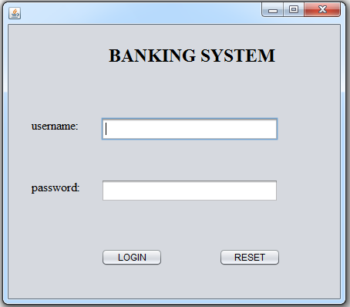
MODULES
1.LOGIN
Notes:
Use a section header for each of the topics, so there is a clear transition to the audience.

Slide 10
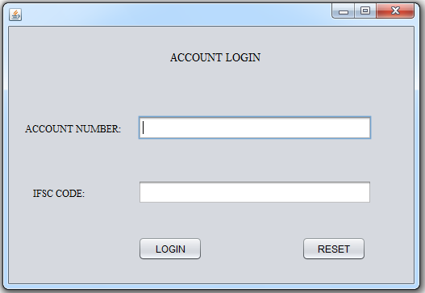
2.USER LOGIN
Notes:
Add slides to each topic section as necessary, including slides with tables, graphs, and images.
See next section for sample table, graph, image, and video layouts.

Slide 11
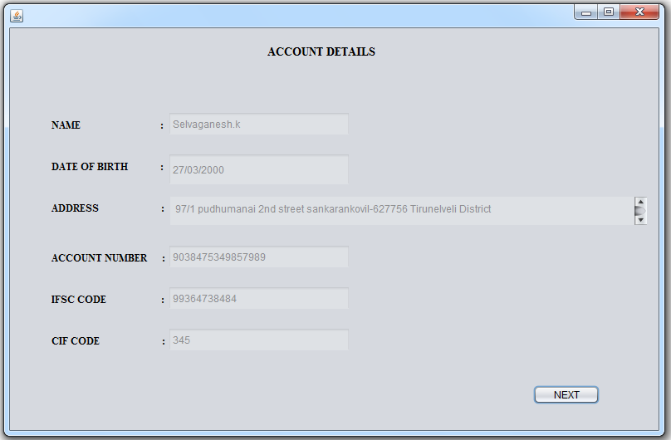
3.ACCOUNT DETAILS
Notes:
Keep it brief. Make your text as brief as possible to maintain a larger font size.

Slide 12
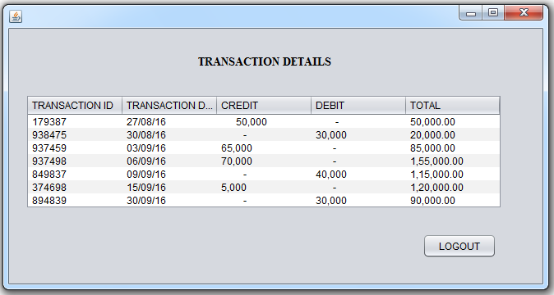
4.TRANSACTION DETAILS

Slide 13
CONCLUSION
This application is very useful for the people who always use banking for their transactions.
It is very easy to know about the banking details, otherwise we need to go to the bank to get the details that will affect the time .
By having in your place we can get the banking details .
Notes:
Is your presentation as crisp as possible? Consider moving extra content to the appendix.
Use appendix slides to store content that you might want to refer to during the Question slide or that may be useful for attendees to investigate deeper in the future.

